Slide 1
NetFlix Data Analysis
Sanjayan Malamel Suresh

Slide 2
About the data
Netflix is one of the most popular media and video streaming platforms. They have over 8,000 movies and TV shows available on their platform. As of mid-2021, they have over 200 Million Subscribers globally. This tabular dataset consists of listings for all movies and TV shows available on Netflix, along with details such as cast, directors, ratings, release year, and duration.

Slide 3
The objective
Understanding what content is available in different countries.
Identifying similar content by matching text-based features.
Network analysis of Actors / Directors and find interesting insights.
Does Netflix have more focus on TV Shows than movies in recent years?

Slide 4
Tools and technologies used
Programming language: Python.
Libraries : Pandas, Numpy, Networkx, Sci-kit Learn, Matplotlib, python-Louvain.

Slide 5
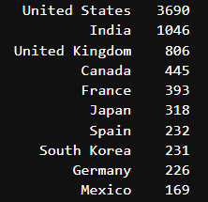
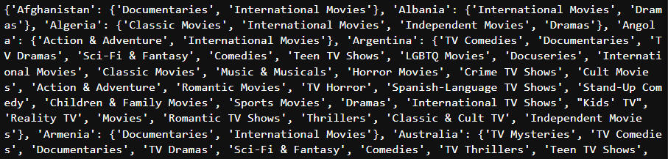
Availability of content
The number of distinct contents available in each country is calculated.
The contents available in each country are stored in a dictionary.

Slide 6
Similar content detection
Similar movies are identified using natural language processing (NLP) techniques.
The movie descriptions provided in the dataset serve as the input text.
The descriptions are vectorised using the TF-IDF method, and cosine similarity is applied to measure textual similarity.
The cosine similarity matrix is sorted in ascending order for each movie.
The top five highest similarity scores for each movie are selected as the most similar content recommendations.

Slide 7
Network analysis of actors
We selected the country with the highest volume of content and analysed its actor network.
Each actor is represented as a node in the network.
An edge between two nodes indicates that the corresponding actors have appeared together in a movie. The edge weight reflects the number of movies in which the pair of actors have co-starred.
The network is processed using the Louvain clustering algorithm to identify underlying community structures, and the actors are grouped into distinct clusters based on their network connectivity.

Slide 8
Network of actors and directors
A directed graph is constructed to represent relationships between directors and actors.
Nodes correspond to both directors and actors.
A directed edge from a director to an actor represents a movie they worked on together, with the edge weight indicating the number of collaborations.
Various centrality measures are computed to identify the most influential directors and actors within the network.

Slide 9
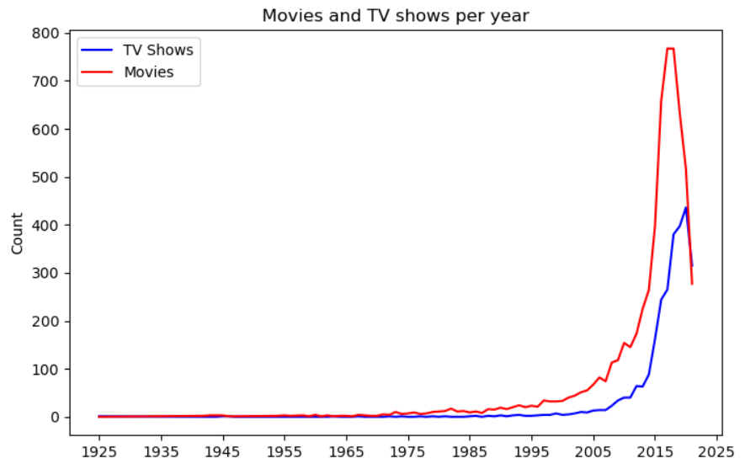
Trend analysis
The number of movies and TV shows per year is aggregated from the data.
The Matplotlib library is used for plotting a line graph.
The trend is evaluated.

Slide 10
THANK YOU

